Slide 1
AI Driven Detection of Fake News Beyond Text
Asa Singh - 2022113
Sargun Singh Khurana - 2022450

Slide 2
Motivation
Fake news detection has become increasingly critical due to the growing impact of misinformation on political discourse, societal trust, and public opinion. As fake news is often designed to look like legitimate content, it is difficult to distinguish it from genuine information. The spread of fake news can affect various domains, such as elections, public health, and even corporate decisions.
This project aims to develop an effective approach for detecting fake news using multimodal data (text, images, and metadata). By combining the strengths of text based features with visual and metadata features, we seek to create a more robust model capable of identifying fake news across different platforms, especially in the context of social media where news is often paired with images.

Slide 3
Literature Review
Fake News Detection on Social Media: A Data Mining Perspective (2018):
This paper presents a comprehensive review of techniques used for detecting fake news on social media. It emphasizes the importance of combining text and image data for better performance. The authors review the use of natural language processing (NLP) techniques like TFIDF for textual analysis and discuss various machine learning models such as SVM, Logistic Regression, and Random Forests for classification tasks. The paper highlights the limitations of using only text features and suggests combining image analysis techniques (e.g., Error Level Analysis) for more robust fake news detection.

Slide 4
Literature Review
MultiModal Fake News Detection in Social Media (2020):
This paper focuses on multimodal fake news detection, where both text and image features are combined. It demonstrates that models trained on multimodal data outperform those using text only data, especially in detecting manipulated images or memes that often accompany fake news. The authors propose using deep learning models to integrate both modalities and evaluate their effectiveness in a real world setting. This aligns closely with our approach of combining textual and image features using ensemble learning techniques to improve fake news classification.

Slide 5
Attributes and Visualization of the Dataset
The dataset used for this project is from a Reddit Based platform called Fakeddit, which contains over 1,000,000 entries labeled for 2-way, 3-way, and 6-way classification. For this project, we focus on 2-way classification (fake vs. real news). Each entry contains the following attributes:
id: Unique identifier for each entry
clean_title: The title of the post
body: The comment or description associated with the post
combined_text: A combination of the title and body, which serves as the primary feature for text based models
upvote_ratio: The ratio of upvotes to total votes for the post
num_comments: Number of comments on the post
score: Reddit score (upvotes downvotes)
subreddit: The subreddit where the post was published
year/month/day: Date information about the post
2_way_label: Binary label (0 for real, 1 for fake)
The dataset consists of 60,000 randomly sampled entries with balanced classes, ensuring that the number of real and fake news examples is approximately equal. This dataset also includes metadata like user engagement, which can provide additional context for fake news detection.

Slide 6
Preprocessing of the Dataset
Preprocessing is an essential step to clean and prepare the dataset for model training. The following preprocessing steps were taken:
Text cleaning: URLs were removed, punctuation was stripped, and text was converted to lowercase.
Handling missing data: Missing values in the dataset (e.g., missing num_comments, upvote_ratio, or score) were imputed using median values to ensure a clean dataset for training.
Text feature extraction: Text was vectorized using the TF-IDF technique to convert it into numerical features. Stopwords were removed to focus on meaningful terms that contribute to identifying fake news.
Image Feature extraction: ELA images were generated from the original images and then various features are extracted for classification, including:
Mean, standard deviation, skewness, and kurtosis of pixel intensity distributions.
Entropy
Texture Features
Edge Features

Slide 7


Detailed Explanation of TF-IDF
1. Term Frequency-Inverse Document Frequency (TF-IDF)
Function TF-IDF is a statistical measure used to evaluate the importance of a word in a document relative to a collection of documents (a corpus). It combines two components:
Term Frequency (TF): Measures how frequently a term t appears in a document d, normalized by the total number of terms in of d:
Inverse Document Frequency (IDF): Measures how unique a term is across the entire corpus, defined as:

Slide 8

Detailed Explanation of TF-IDF
TF-IDF Formula: The TF-IDF score for a term in a document d is given by:
A higher IDF means that the term is rare across the corpus, which suggests it is more informative.
If a term appears in every document (i.e., it is common across the corpus), its IDF will be close to zero.
If a term appears in only a few documents, its IDF will be larger, indicating it's more distinctive and likely to be important.
Why TF-IDF is Useful
Relevance: TF-IDF helps rank words according to their importance within a document. Words that are frequent in a document but rare across the corpus are more important, making TF-IDF useful for tasks like information retrieval and document search.
Dimensionality Reduction: It’s often used in text preprocessing for tasks like text classification or clustering because it can reduce the importance of common words (like "is", "the", "and") and focus on more meaningful terms.
Filter Out Common Words: It naturally filters out commonly occurring terms that do not help in differentiating documents, helping machine learning algorithms focus on more distinctive features.

Slide 9
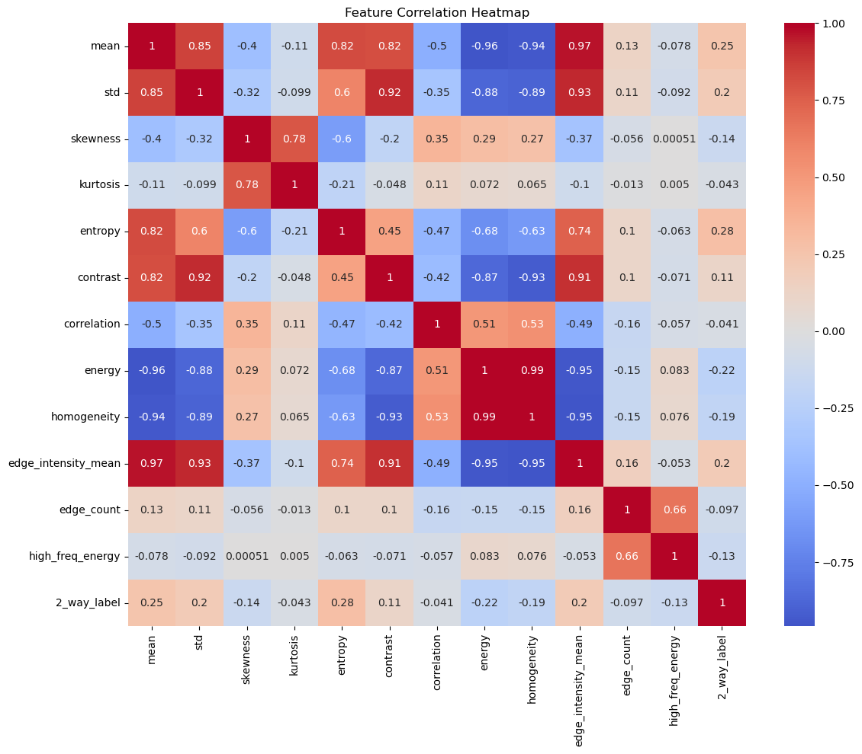
Error Level Analysis (ELA)
ELA is a technique used to identify inconsistencies in image compression levels, which can reveal manipulations or edits. It works by comparing the compression artifacts of an image at different levels.
Process of ELA:
Compress the image at a known quality level (e.g., 95% JPEG).
Subtract the recompressed image from the original image.
Generate an ELA image that visualizes the differences between the two.
Features Extracted: From the ELA images, the following features are computed:
Statistical Features: Mean, standard deviation, skewness, and kurtosis of pixel intensity distributions.
Entropy: Quantifies the randomness in pixel intensities.
Texture Features: Describes patterns within pixel arrangements.
Edge Features: Captures boundaries and transitions in pixel intensity.

Slide 10
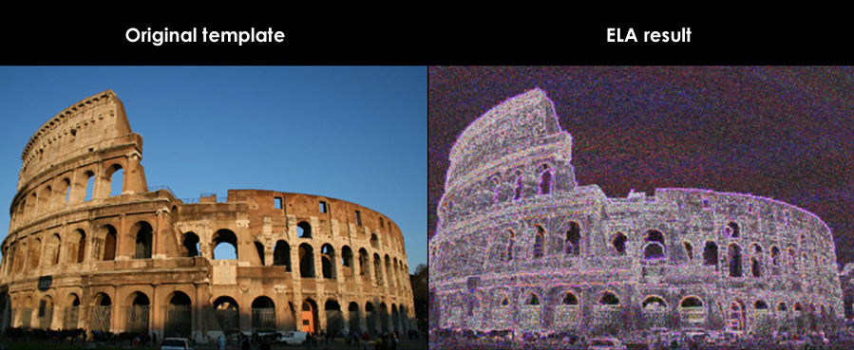
ELA example

Slide 11
Methodology
Our methodology involves a multistep process:
Text Model: The text data is preprocessed and vectorized using the TF-IDF technique. We use machine learning models such as Logistic Regression, Random Forest, and Support Vector Machine (SVM) for training. These models are evaluated based on their classification accuracy and ROC-AUC scores.
Image Model: For the image based features, Error Level Analysis (ELA) is applied to detect image manipulations. We extract features from the images (e.g., entropy, texture features) and train classifiers like Random Forest and XGBoost on these features.
Ensemble Model: The final model combines the predictions from the text and image models using a meta classifier. This allows the model to leverage both the textual and visual features for enhanced fake news detection. We experimented with various ensemble methods like Logistic Regression and XGBoost to determine the best performing model.

Slide 12
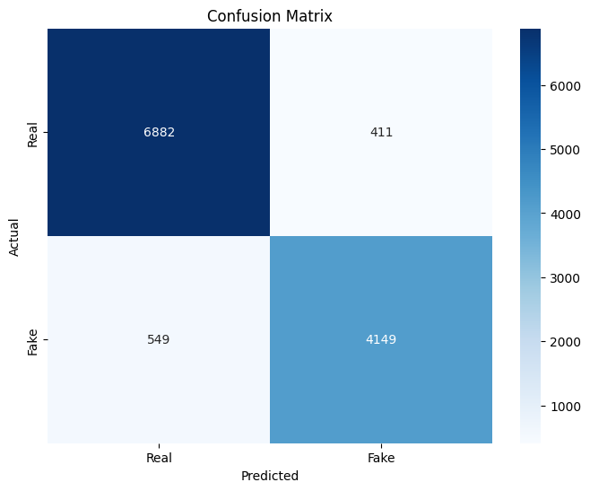
Results
Image only Model (XGBoost): Achieved an accuracy of 73.14% in detecting fake news using image features.
Textonly Model (Random Forest): Achieved an accuracy of 83.48% using TF-IDF vectorized text features.
Ensemble Model (XGBoost): Outperformed both the image only and text only models with an accuracy of 91.99%. This demonstrates the power of combining text and image features along with metadata.

Slide 13
Analysis
The ensemble model provided a significant improvement in accuracy over the unimodal approaches. This was largely due to the synergy between the text and image models, which allowed the ensemble model to detect fake news more effectively. The confusion matrices for each model show that the ensemble approach reduced both false positives and false negatives compared to individual models.

Slide 14
Conclusion
Key Achievements
Multimodal Integration: The project successfully demonstrated that combining text, image, and metadata features significantly enhances the ability to detect fake news. This multimodal approach captured nuances that unimodal methods could not.
Improved Accuracy and Robustness: The ensemble model achieved higher classification accuracy and reduced error rates compared to individual models. It proved particularly effective in scenarios involving:
Deceptive text with authentic images.
Manipulated images paired with neutral or misleading text.
End-to-End System: A fully functional pipeline was implemented for text preprocessing, image feature extraction (using ELA), and ensemble model training. This system can be extended to real-world applications for fake news detection.

Slide 15
Conclusion
The Project successfully demonstrated the potential of multimodal fake news detection. By combining text, image, and metadata features, we were able to achieve higher classification accuracy and robustness. Future work could explore deep learning techniques for even better feature extraction and classification.
Challenges Faced
Data Limitations: The dataset contained imbalances in the type of fake news (e.g., visually manipulated vs. textually deceptive), which required careful preprocessing and augmentation.
Computational Complexity: Training the ensemble model required significant computational resources due to the need for fine-tuning both text and image models

Slide 16
Timeline
Week 1-2: Literature review and dataset exploration, identifying key research papers and understanding dataset characteristics.
Week 3: Data cleaning and preprocessing, handling missing values, outliers, and normalization.
Week 4: Feature engineering, selecting relevant features and transforming data for model input.
Week 5: Model training and initial performance evaluation, followed by comprehensive testing of the model.
Week 6-8: Model optimization and hyperparameter tuning, experimenting with different models like SVM, Random Forest, Decision Trees (DT), Logistic Regression (LR), and refining performance
Week 9-10: Cross-validation and model evaluation, ensuring robustness through multiple performance metrics.
Week 11: Model validation with test data, performing final checks and refining model based on feedback.
Week 12: Results analysis and reporting, summarizing findings and preparing for final presentation.

Slide 17
Contributions
Asa Singh: Lead on dataset cleaning, image model development using Error Level Analysis (ELA), and ensemble model implementation. Contributed to the writing of the methodology, results, and conclusion sections.
Sargun Singh Khurana: Lead on text preprocessing, TF-IDF vectorization, and training of text based models. Contributed to model evaluation, analysis, and report writing.

